Slide 1
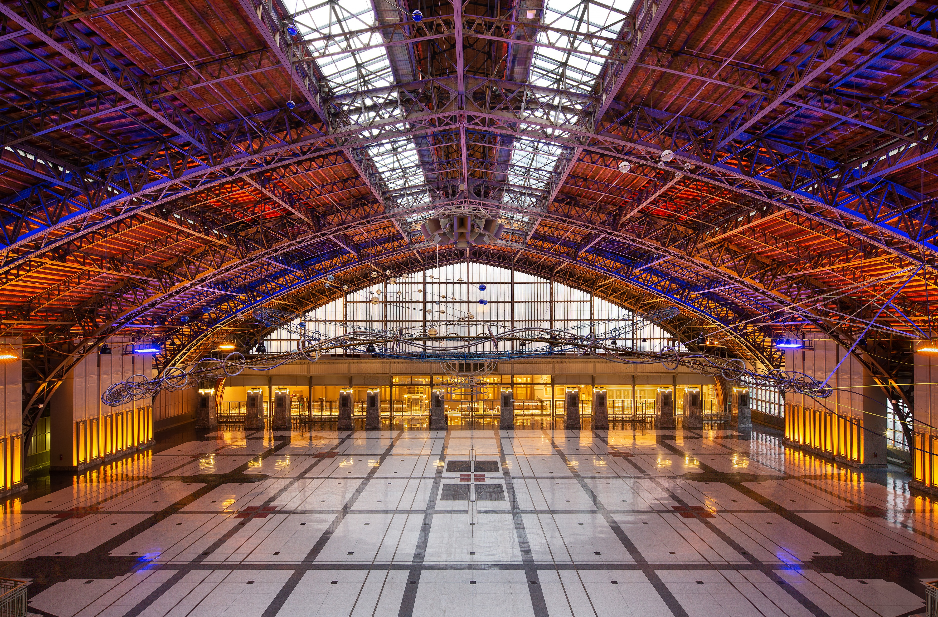

WELCOME
Pennsylvania Convention Center
Thank you for your business!
We continue to improve our services to ensure the success of your event in Philadelphia!

Slide 2
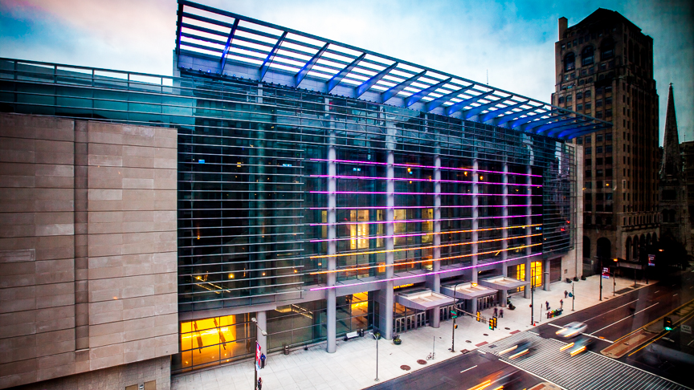
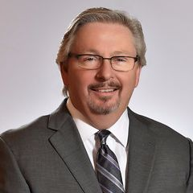

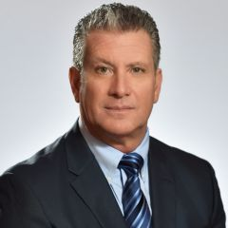
Greg Tesone
Assistant General Manager
Mary Ann Torres
Director of Business Analysis
Dave Salera
Director of Contractor Services

Slide 3
The PCCA is pleased to offer Show Organizers an enhanced Customer Satisfaction Agreement which will provide an even more cost-effective and productive experience.
The PCCA’s trade partners share our commitment to producing successful events, and have agreed to these expanded work rules through May 2029.
Improved exhibitor rights have been established in the agreement that allow for unprecedented options for exhibitors not matched in other facilities.
Notes:
The PCC Authority listened to our customers. They recognized the challenges we faced and resolved to make changes. The PCCA was very hands-on in terms of meeting with customers, understanding their concerns, and evaluating how they could make improvements to address those concerns.
Board established a 4 pronged approach to improving competitiveness of Center: changing the building management model, addressing the labor-supplier model, enhancing exhibitor rights, and improving contractor and billing transparency.

Slide 4
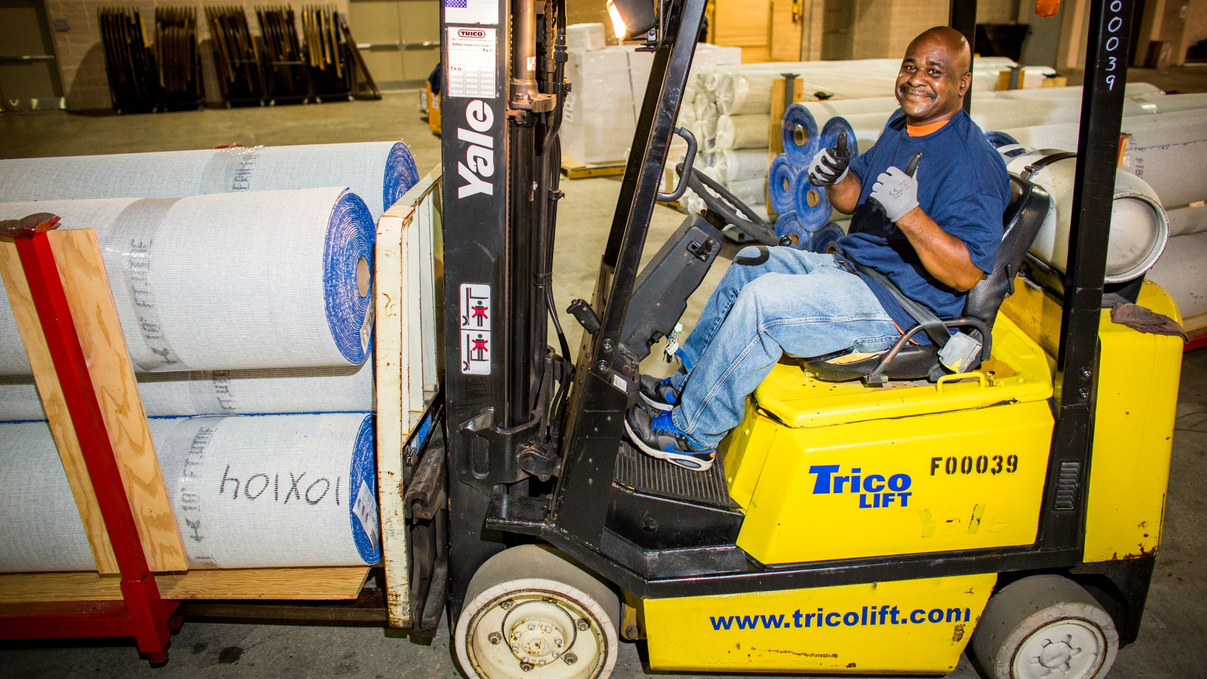




Labor Agreement
10-year term with four signatory partner unions:
More streamlined and efficient jurisdictions that are clearly defined
Skilled and capable workforce
Continuous hospitality training
ELECTRICIANS
LABORERS
RIGGERS
STAGE HANDS
Notes:
SMG engaged in negotiations with new partners, the four trades – electricians, laborers, stagehands and riggers – to improve the show floor experience for meeting planners.
Have emphasized a core team at the building that includes people who have been with us on repeat shows.
Agreement gave customers more choices; e.g. you can pick a foreman or a worker by call by name.

Slide 5
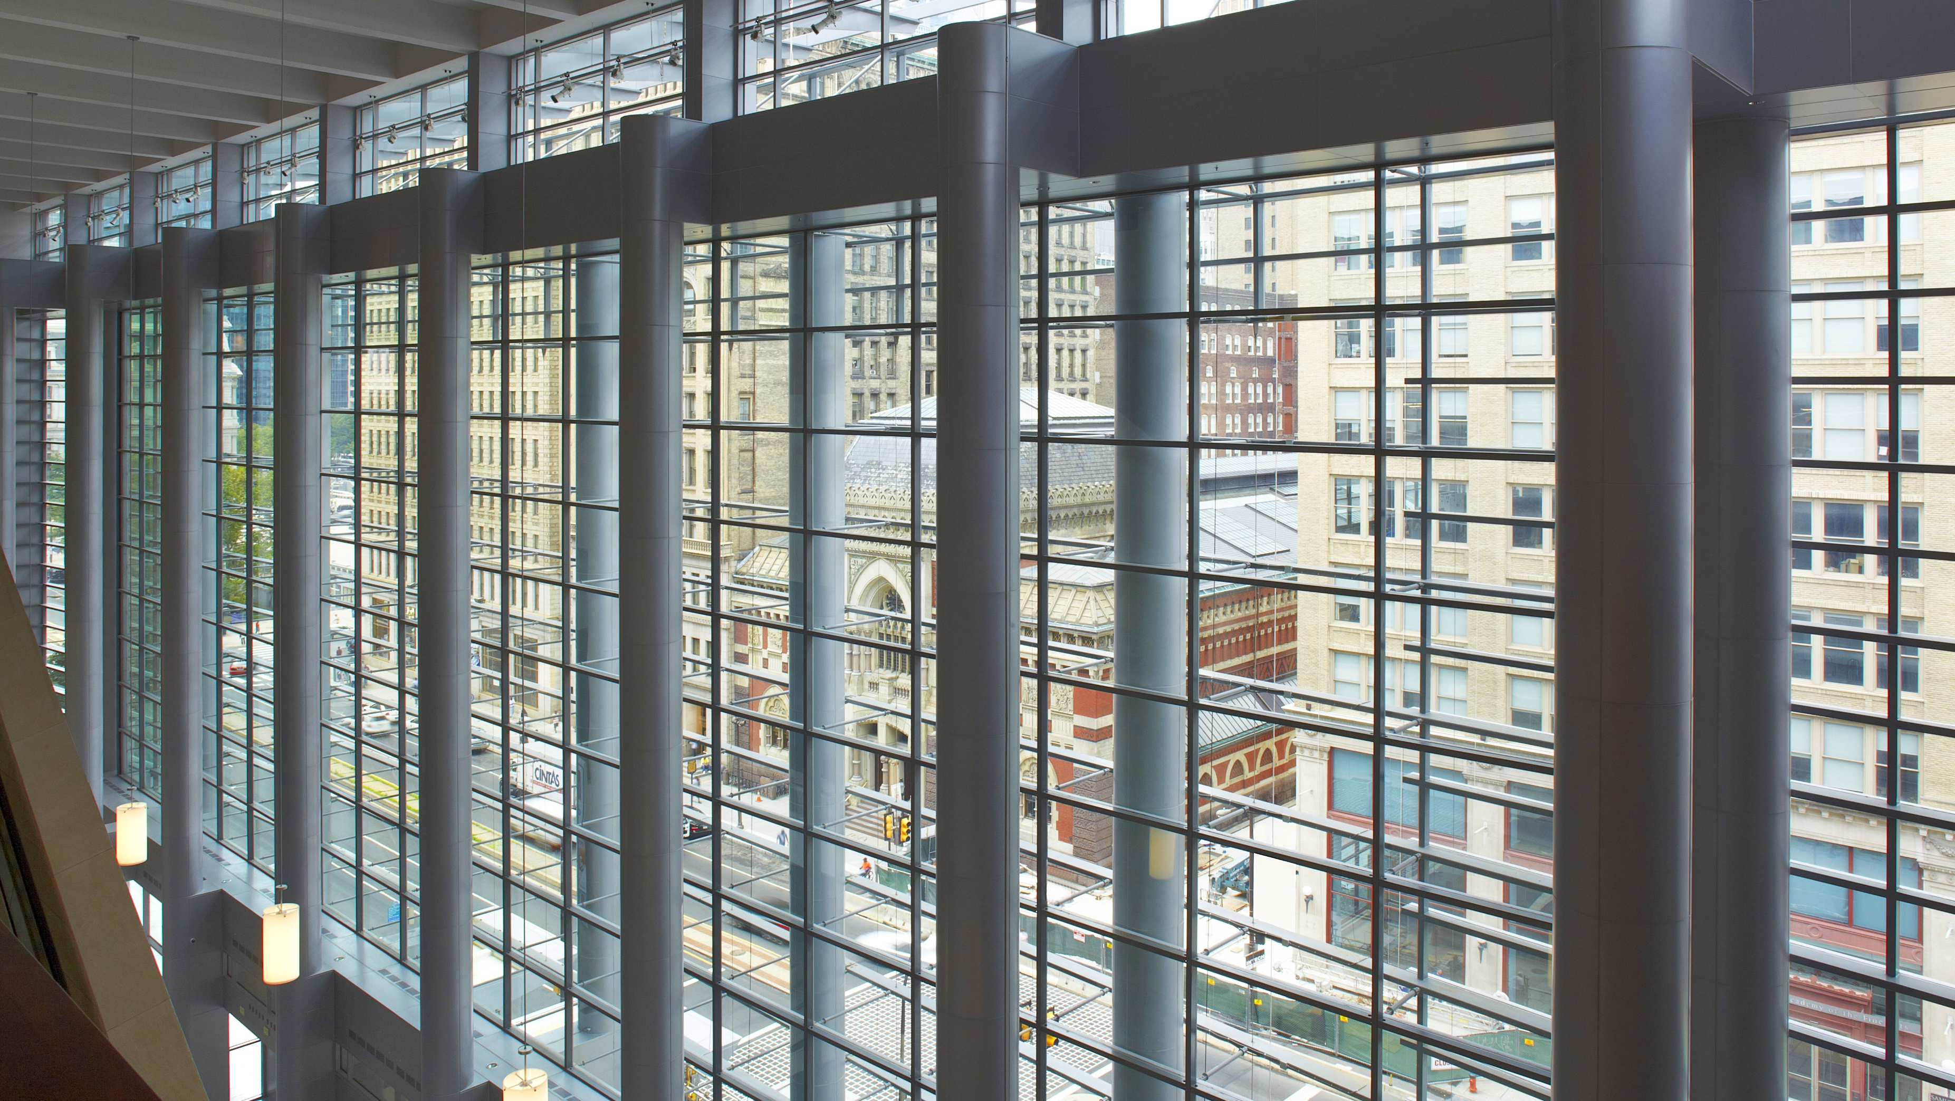
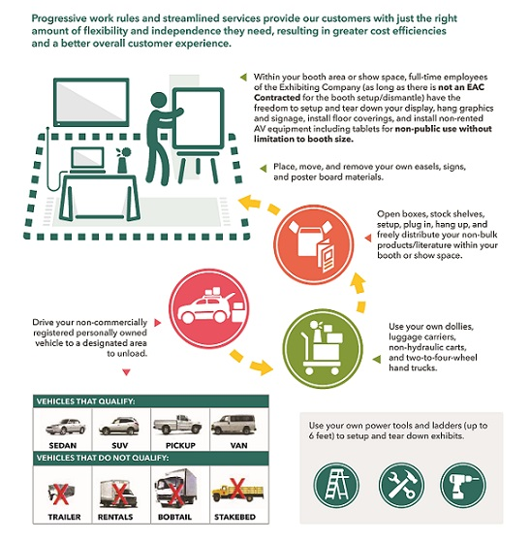
Enhanced Exhibitor Work Rules
Progressive work rules and streamlined services provide our customers with just the right amount of flexibility and independence they need, resulting in greater cost efficiencies and a better overall customer experience.

Slide 6
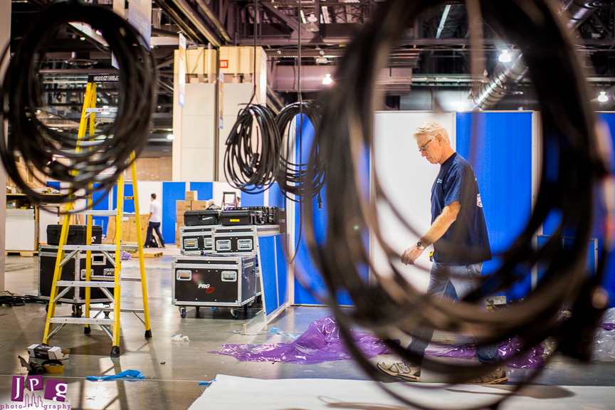

Enhanced Customer Satisfaction Agreement
Labor Stability through May 2029
Unlimited Booth Size
  Full-time employees of exhibiting companies (as long as there is not an EAC contracted for the booth setup/dismantle) have the freedom to:
  Setup and tear-down their display
  Hang graphics and signage
  Install non-rented AV equipment
  Install floor coverings
  Install and remove audio/visual equipment within the booth, excluding rental equipment.

Slide 7

Enhanced Customer Satisfaction Agreement
Computers
  Show Management may install any personal or company owned computers for registration and Show Management licensed areas for non-public use.
Notes:
Impact: Reduced man hours and reduction in costs.
Eliminated composite labor call (SH & Electrician). Eliminates minimum 4 hour labor call for stagehand. There is no minimum 4 hr labor call for electrician.

Slide 8


Enhanced Customer Satisfaction Agreement
Show Management and Customers may put out pop up retractable signs.
Show Management may place easel signage.
  Signs or easels will be delivered to a central location for Show Management & Customers to move to an appropriate location.
  Excludes frame signs & meter boards
Notes:
Reduction in labor cost.
Eliminates wait time – labor moving signs from Point A to Point B.

Slide 9
Open for Q & A

Slide 10

PCC Contact Information
Please direct all questions you may have to:
Contractor Services
Phone: 215-418-4900
Email: csaquestions@paconvention.com

Slide 11
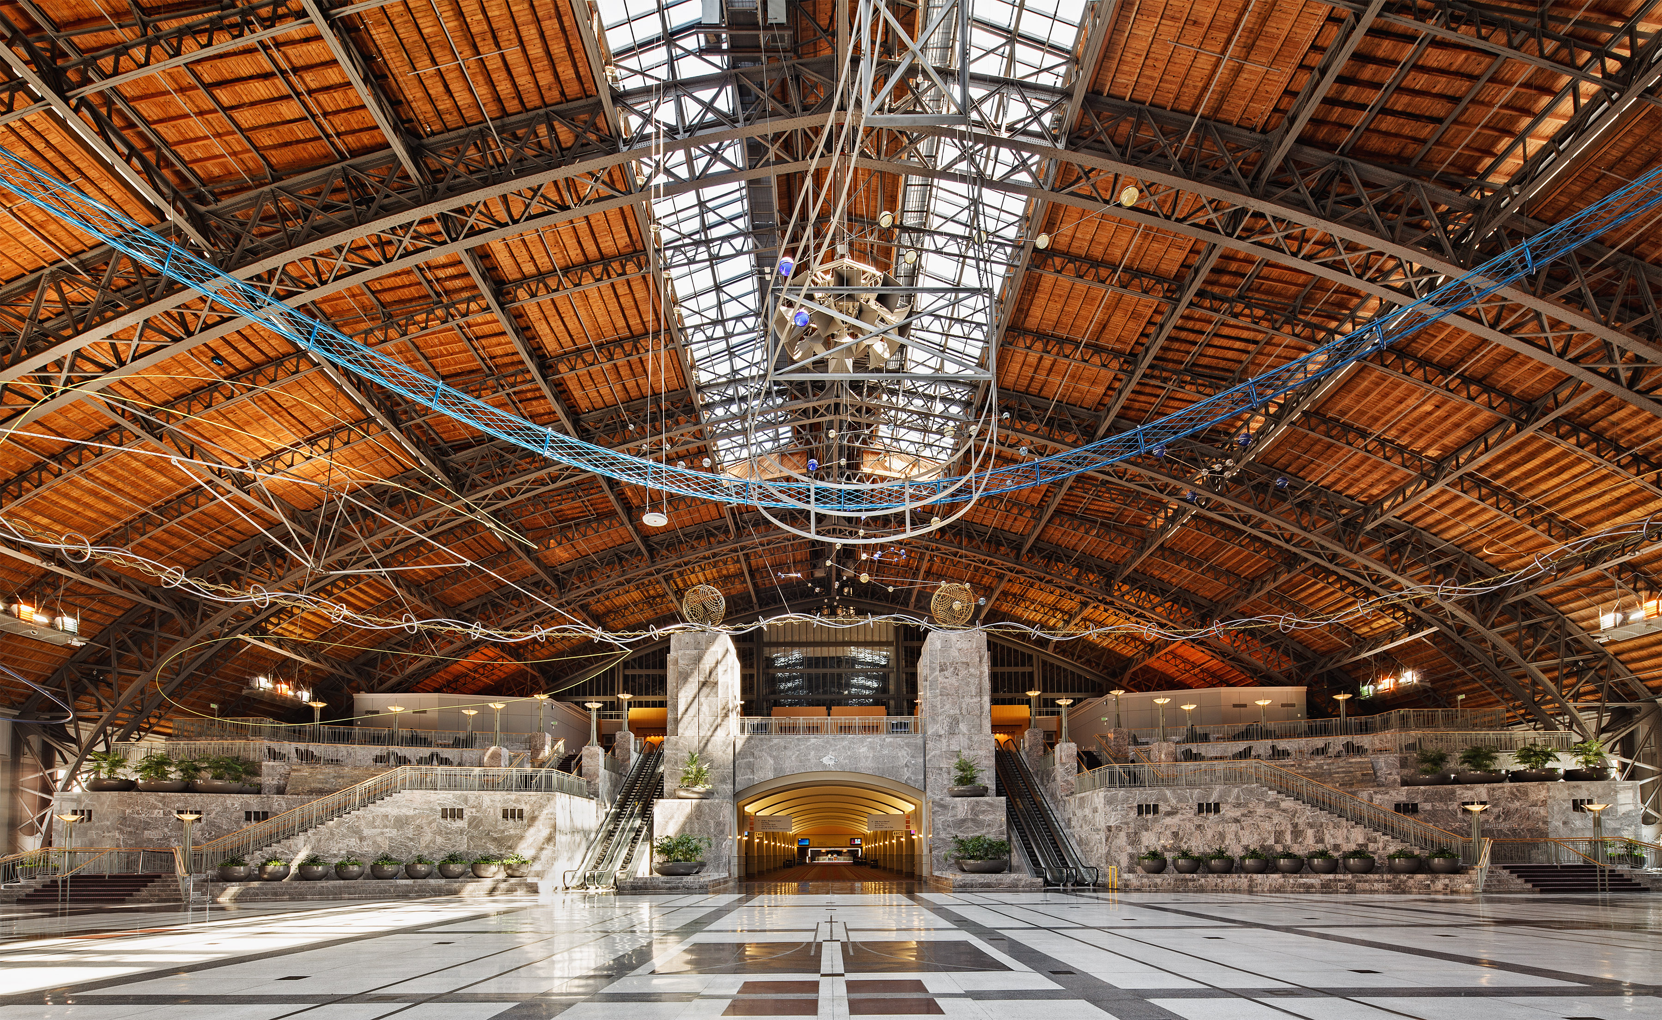
See you in Philadelphia!

